Slide 1
Using Reinforcement Learning and Algorithmic Techniques to Develop Strategies for Tournament-Style Backgammon Matches
Reasoning behind alterations to the initial plan
Problems faced and how they were solved
Plan and deliverable justification
Progress on deliverables

Slide 2
Plan vs Reality
Initial Plan | Re-evaluated Plan | Reason for change
ACO as third intermediate deliverable | Expectimax as third intermediate deliverable | Backgammon volatility
Report started by Week 11 | Report to be worked on while advanced models are training | More efficient, wasting less development time
Greedy Agent development to only take 1 week | Greedy Agent development took 4 weeks in total | Unable to locate source of bias; knock-on to genetic
All coursework to be completed by Week 11 | Coursework was completed in Week 13 | Poor parallelisation of deep learning training time

Slide 3


Deliverables
Basic
Random Agent
Robust Game Environment
Graphical User Interface (GUI)
Intermediate
Greedy Agent
Genetic Agent
Expectimax Agent
Advanced
Reinforcement Learning Agent
Machine Learning Agent
Agent that changes strategy based on state of the game

Slide 4
Robust Game Engine
Critical to ensure the deep learning and reinforcement learning agents are trained on accurate rules of the game so that they don’t make illegal moves
Allows the simulation of real-life backgammon games
Allows for direct comparison between different agents
Confirmed by viewing and playing hundreds of games with no illegal moves or errors

Slide 5
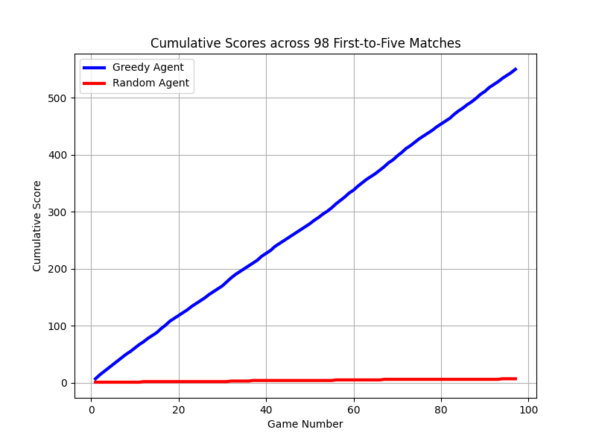
Random Agent
Generates random integers until they form valid moves
Developed to test the robustness of the game engine and provide a beginner-level opponent for user and baseline testing
Helped locate errors with rolling doubles, entering and bearing off
Wins ~1 point every 100 first-to-five matches against opponents with knowledge of the rules and moves available
Final Score: 545-2
Rounded Average score: 6-0

Slide 6
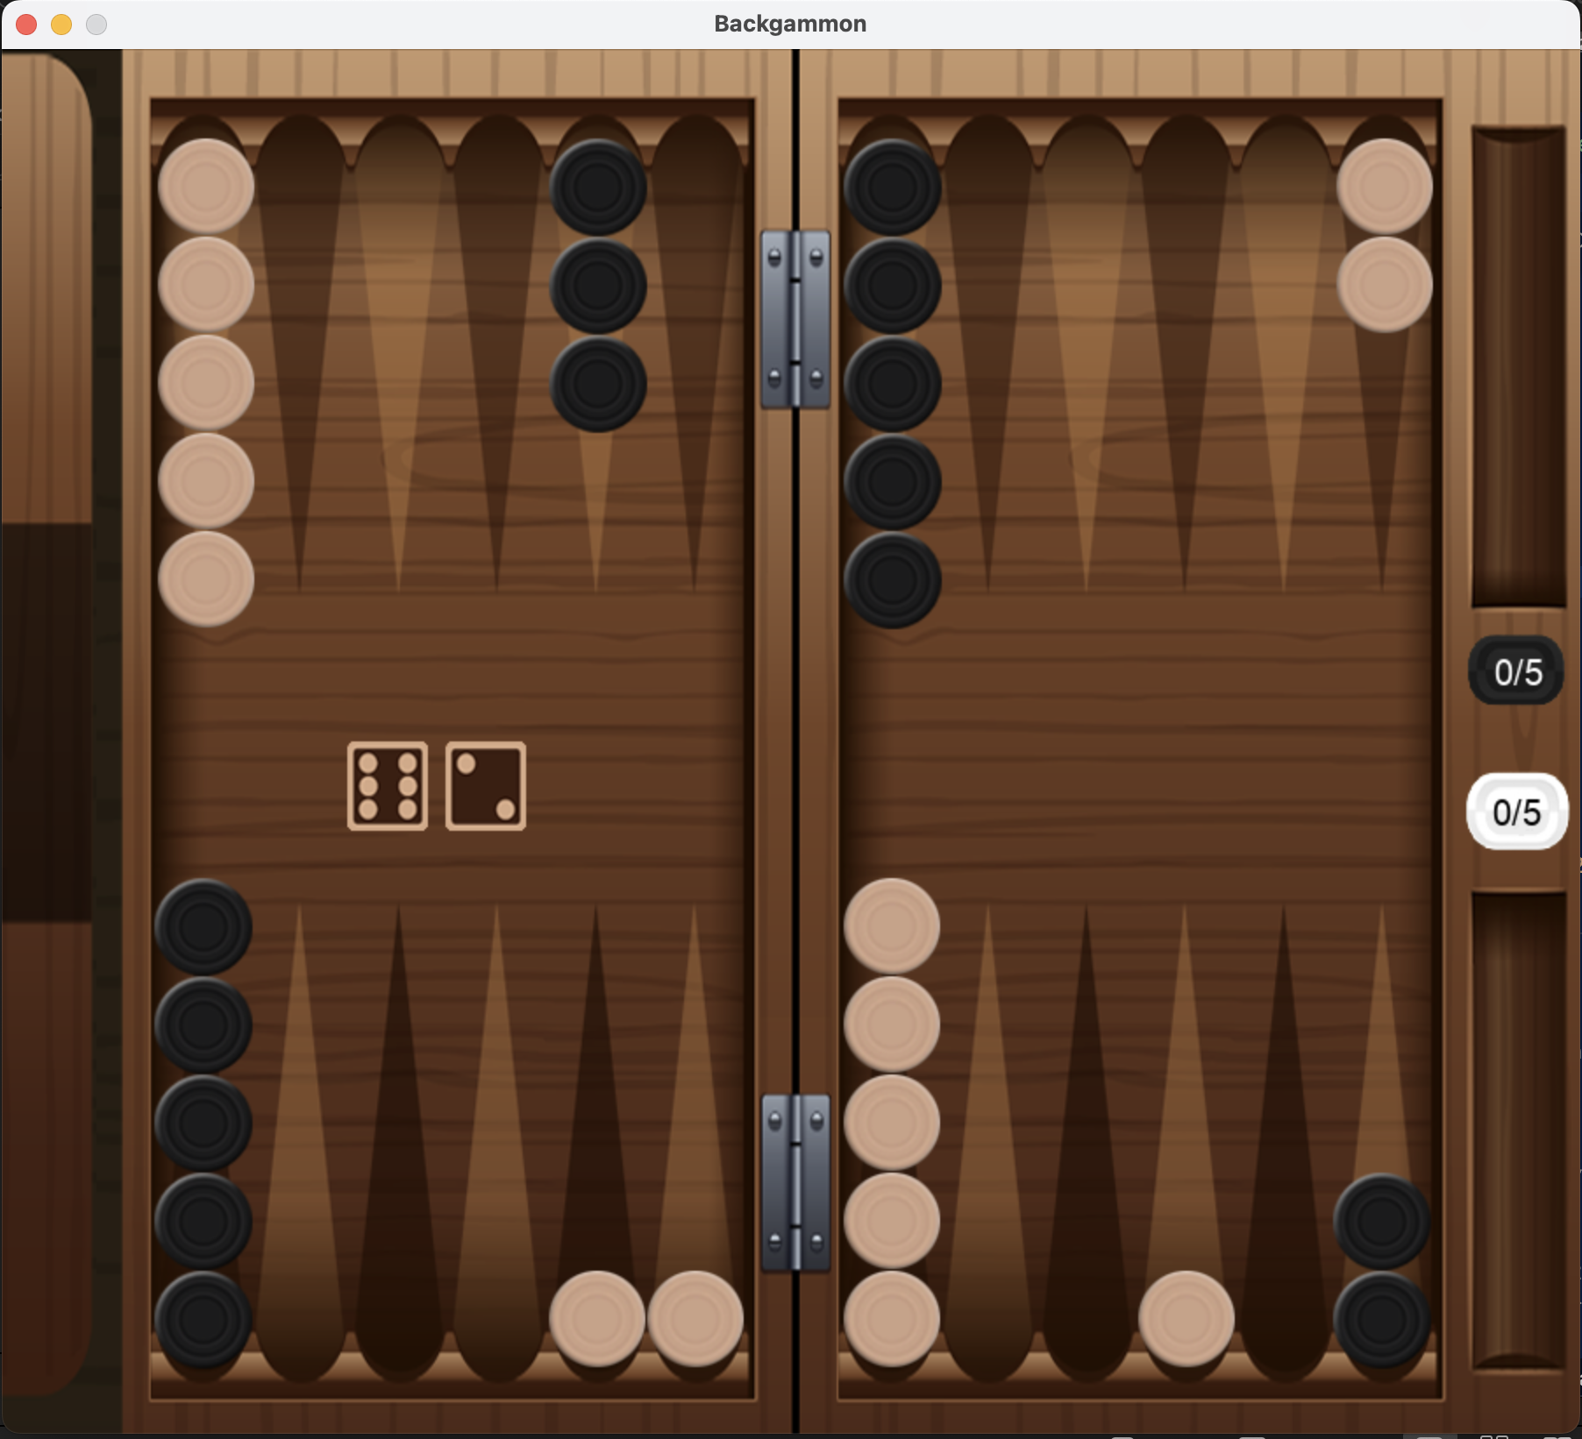
GUI
Extremely useful for viewing games and analysing decisions
This has been vital in debugging various issues with agents
Especially with the Greedy Agent
Allows humans to play agents without knowledge of backend program, paramount for user testing
Allows for direct comparison between different agents

Slide 7
Greedy Agent
Scores each possible resulting board
Utilises 17 hard-coded weights and nested conditional statements
In the case where multiple resulting boards have the same score, a tiebreaker occurs.
Tiebreaker was introduced to remedy unintended bias
Always chooses the predefined best move
No lookahead
Completed before all other intermediate deliverables
They would require features present in the Greedy Agent’s code

Slide 8
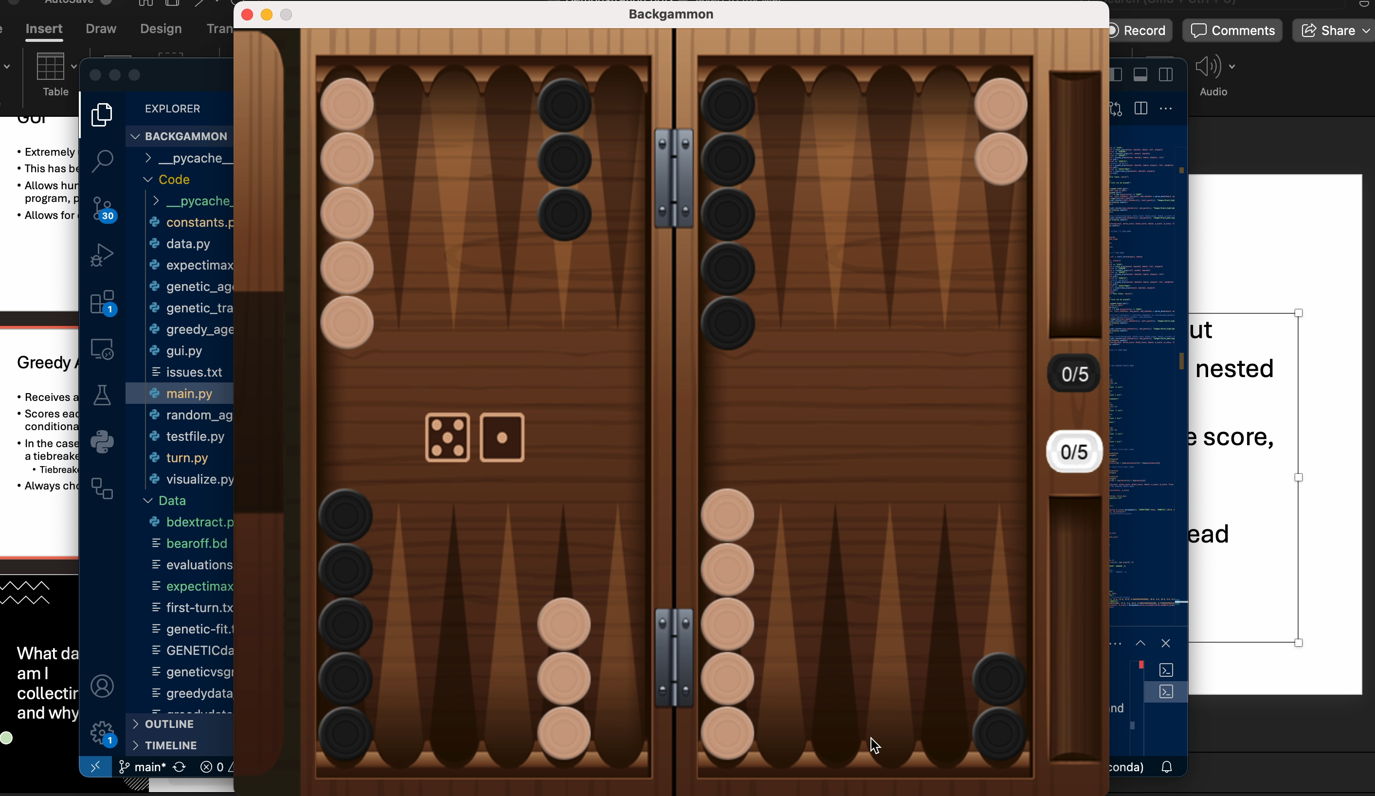
Notes:
Maintains number of anchors, prioritises moving pieces into home. Exposes blot because it has to. Notes opportunity to increase number of walls and does so

Slide 9
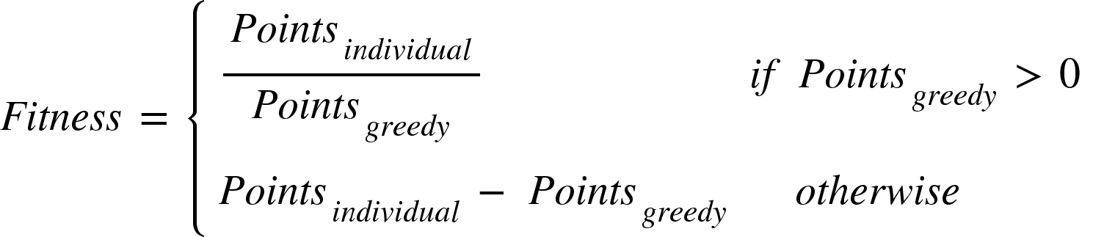
Genetic Agent
All the nested conditions from the greedy agent were flattened
Initial population has randomly generated weights
Fitness is determined by first-to-five matches of the individual vs the greedy agent:
All individuals with a fitness greater than 5 then coevolve against each other in first-to-25 matches until only one remains.
Remaining individual is then chosen to be the genetic agent

Slide 10
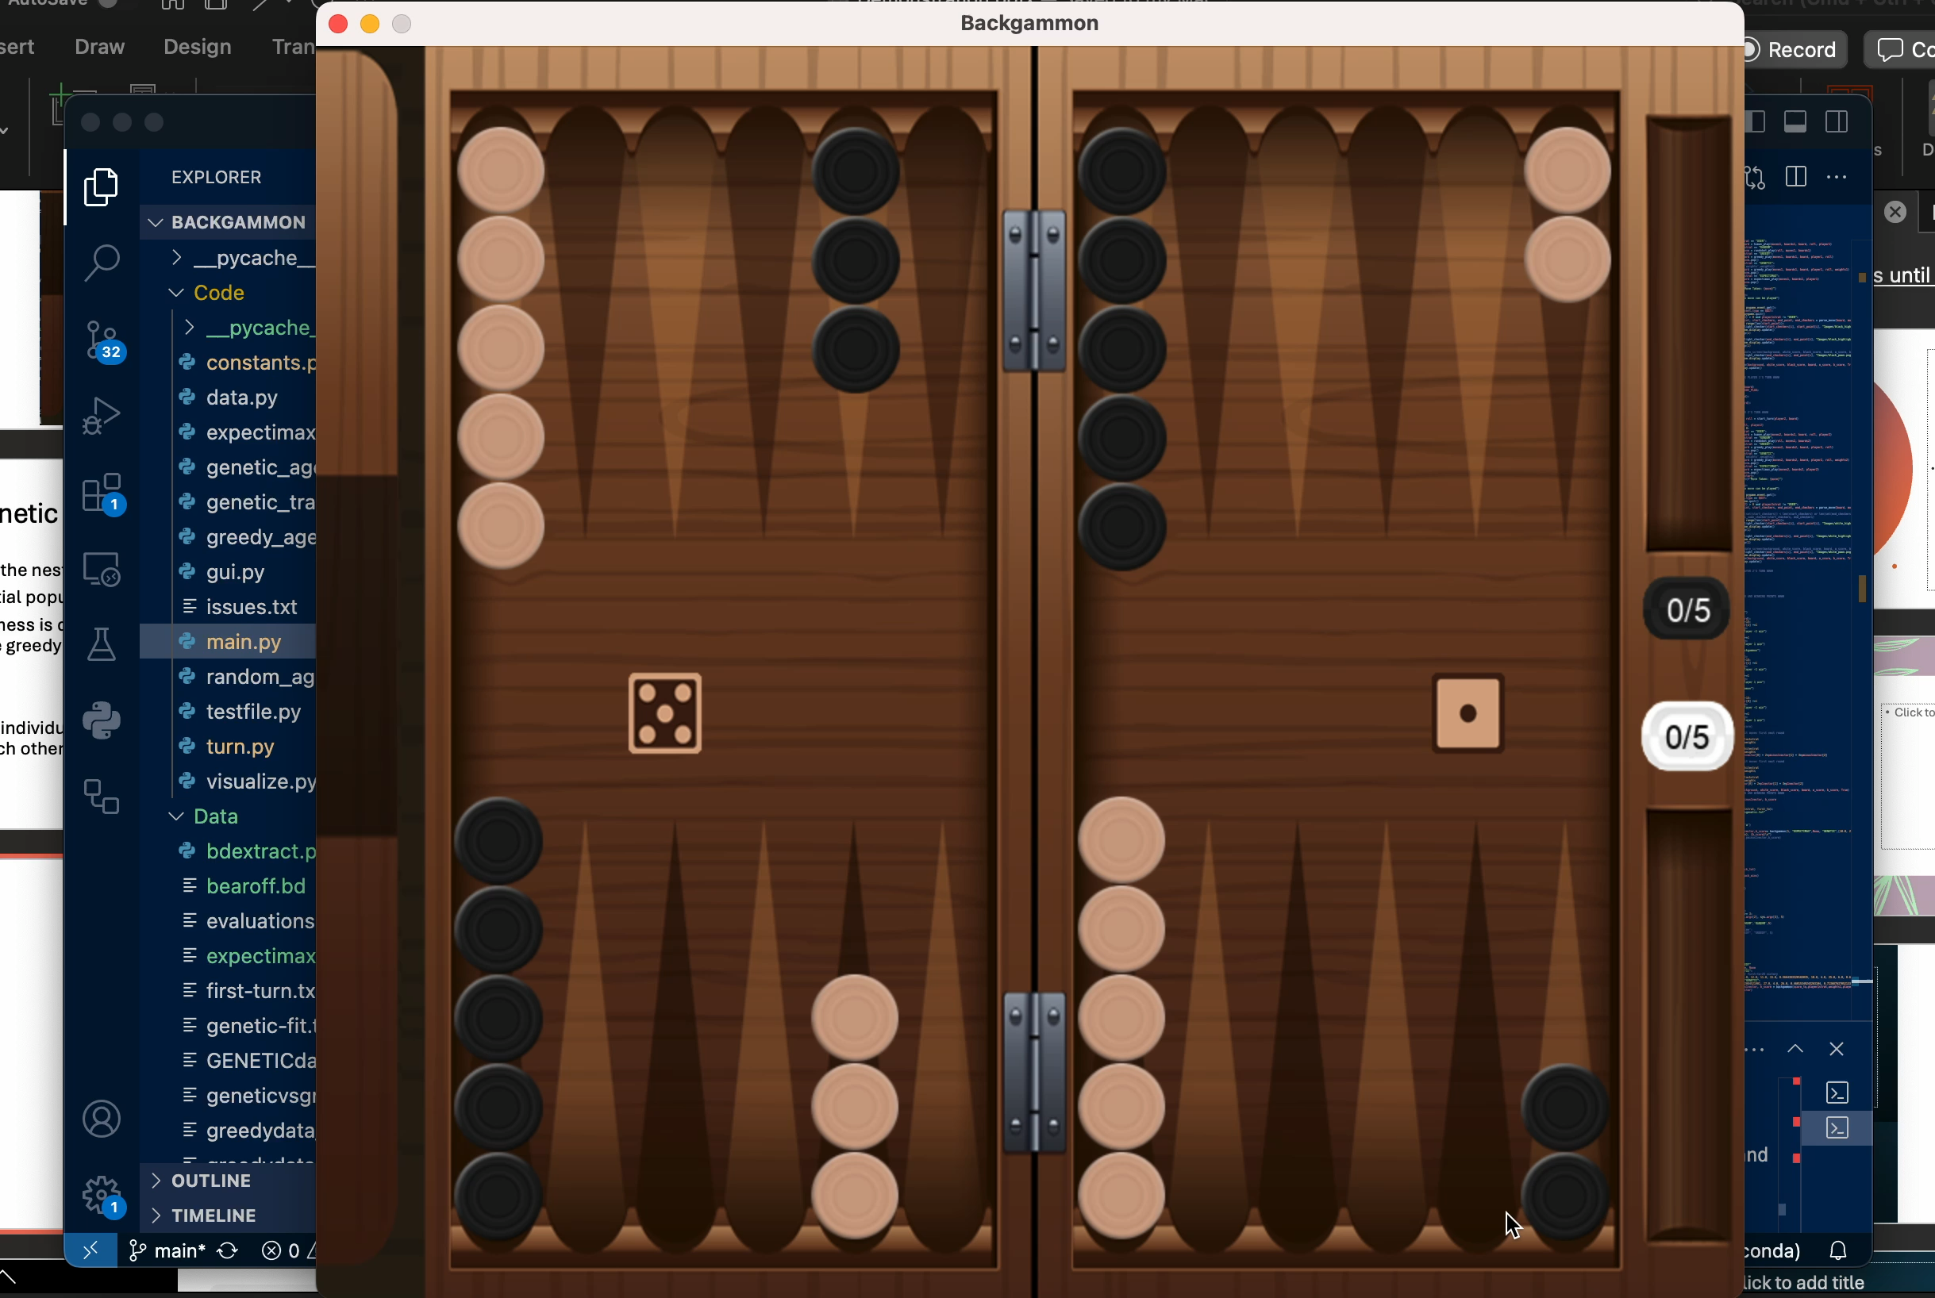
Notes:
White is genetic. Exposes blot differently, reducing the probability it can be hit off. Sets up opportunity to introduce a prime.

Slide 11
Expectimax Agent
The agents checks which move is theoretically worst for the opponent and plays it
Uses the greedy agent’s evaluation function to score each of the opponent’s possible follow-up moves
Then chooses the move that minimizes the score of the opponent’s follow-up

Slide 12
Comparison of Agent Performance
Expectimax vs Greedy across 5000 games
2436-2574 wins.
Expectimax vs Genetic across 1000 games
431-569 wins
Genetic vs Greedy across 10,000 games
5478-4522 wins
3157-3898 final score
567-898 final score
7401-6068 final score

Slide 13
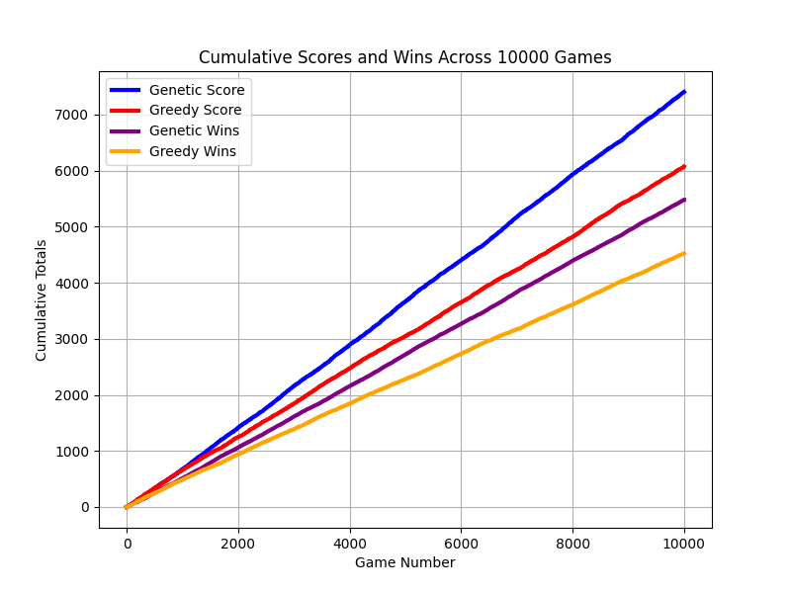
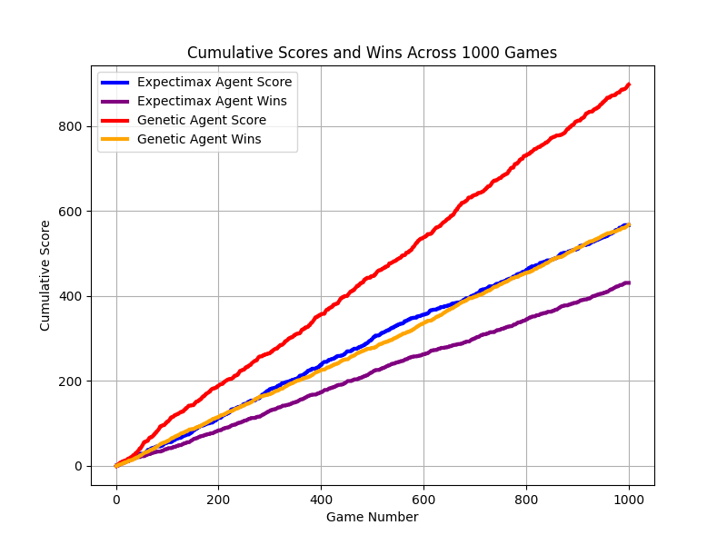
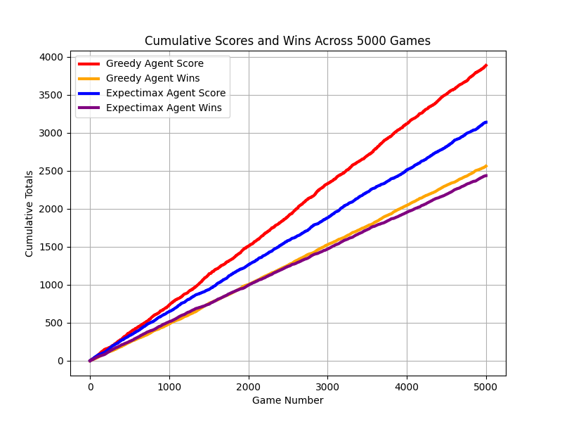
Visualisation of Results throughout testing
Genetic vs Greedy
Genetic vs Expectimax
Greedy vs Expectimax
Genetic agent +0.133ppg
Genetic agent +0.331ppg
Greedy agent +0.148ppg
Genetic wins 54.8%
Genetic wins 56.9%
Greedy wins 51.5%

Slide 14
Adaptive Agent
Utilises different strategies at different phases of the game
Turn 1 uses the Greedy evaluation function
In a bear-off race uses Matussek’s game-winning-chance formula for optimally bearing-off and positioning checkers
If high risk of being gammoned, moves furthest piece back
Otherwise uses 30-parameter equity calculation to board strength and game-winning-chance
If equity tie, uses one-move lookahead to probabilistically make best move
Notes:
https://bkgm.com/articles/Matussek/BearoffGWC.pdf?utm_source=chatgpt.com

Slide 15
Doubling Heuristics
7-parameter equity calculation for intermediate agents
Factors in pip differential, blot count, home board strength and more
Currently implemented “basic” doubling strategy:
Player doubles if equity > 0.5, drops if equity < -0.5
Adaptive agent will use more sophisticated doubling strategy based on Keeler and Spencer’s algorithm
Other advanced models will use neural networks
Notes:
https://www.bkgm.com/articles/KeelerSpencer/OptimalDoublingInBackgammon/
If your count is x, and your opponent’s is y:
you double if:y ≥ (11/10)x − 1.he folds if:y ≥ (11/10)x + 2.

